Slide 1

Django JWT Authentication
JSON Web Tokens for Secure API Authentication
Program: EDGE-CSE CUET DIGITAL SKILLS TRAINING
Course: Python (Django) [Intermediate]
Lecture: Training Session-13 Date: 26th October, 2024 Duration: (1+1) hours
Instructor: Tanveer Rahman, Sr. Software Engineer, Friends Corp. Chuo-ku, Tokyo, JP shakil10vr@hotmail.com, 01626735005

Slide 2
Agenda
What is JWT?
Why Use JWT for Authentication?
Setting Up JWT Authentication in Django REST Framework
Creating and Using JWT Tokens
Practical Task: Implementing JWT Authentication

Slide 3
What is JWT?
JWT (JSON Web Token)
JWT Structure:
A compact, URL-safe means of representing claims between two parties. Consists of three parts: Header, Payload, and Signature.
Header.Payload.Signature Encoded as a base64 string.

Slide 4
Why Use JWT for Authentication?
Stateless Authentication:
Does not require server-side sessions; tokens are self-contained.
Security:
Scalability:
Suitable for microservices and distributed systems.
JWTs are signed to ensure data integrity. Can include additional claims to manage token expiration and user roles.

Slide 5
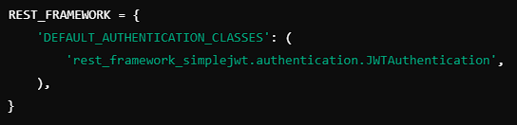
Setting Up JWT Authentication in Django REST Framework
Install Required Packages:
pip install djangorestframework-simplejwt
Update Django Settings:
Add 'rest_framework_simplejwt.authentication.JWTAuthentication' to DEFAULT_AUTHENTICATION_CLASSES in settings.py.

Slide 6
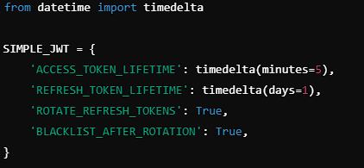
Configuring JWT Settings
Customizing JWT Settings:
Explanation:
ACCESS_TOKEN_LIFETIME: Time for token validity.
REFRESH_TOKEN_LIFETIME: Time for refreshing token validity.
ROTATE_REFRESH_TOKENS: Automatically issue a new refresh token.

Slide 7
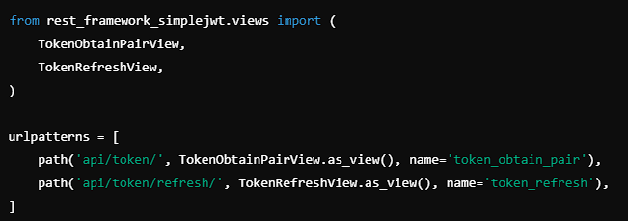
Creating JWT Tokens
Create JWT Views:
Explanation:
TokenObtainPairView: Generates access and refresh tokens. TokenRefreshView: Refreshes the access token.

Slide 8
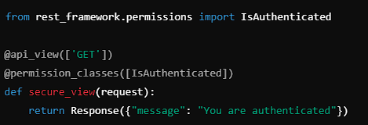

Securing Views and Decorators
Using @permission_classes Decorator:
Setting Permissions in Views or Viewsets:

Slide 9
Using JWT Tokens in API Requests
Add Authorization Header:
Example Using cURL:
Authorization: Bearer <your_access_token>
curl -H "Authorization: Bearer <your_access_token>" http://localhost:8000/api/your_endpoint/

Slide 10
Task 1 - Implementing JWT Authentication (45 mins)
Configure JWT in a Django REST Framework project.
Set up endpoints for obtaining and refreshing tokens.
Secure an existing API endpoint using JWT authentication.
Test the protected endpoint by including the JWT in the request header.

Slide 11
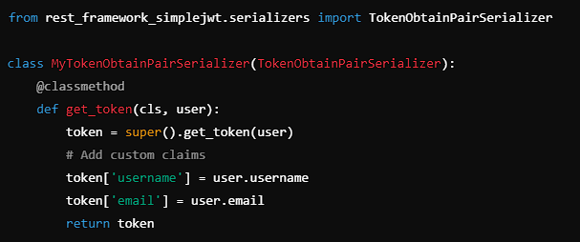
Customizing JWT Claims
Override the TokenObtainPairSerializer:
Allows adding custom data (claims) to the token.

Slide 12
Task 2 - Custom JWT Claims (30 mins)
Modify the token serializer to add custom claims like user role.
Implement a protected endpoint that uses these custom claims.
Test the endpoint with various users and roles.

Slide 13
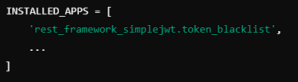

Revoking JWT Tokens
Install Blacklist App:
pip install djangorestframework-simplejwt[blacklist]
Enable Token Blacklisting:
Enable Blacklisting in Settings.py:

Slide 14
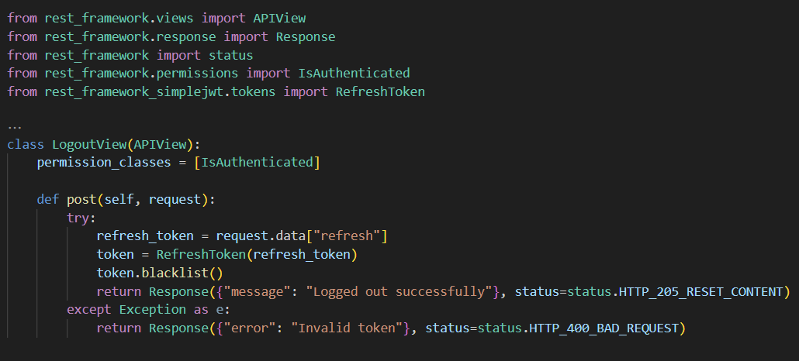
Logout API Implementation
Create a View for Logout:
Retrieves the refresh token from the request and blacklists the token to prevent further use.

Slide 15
Recap
JWT Overview: Stateless, secure authentication.
Setting Up JWT: Configure simplejwt in Django.
JWT in Practice: Obtaining, using, and refreshing tokens.
Custom Claims and Security: Enhance tokens with additional claims.
Token Revocation: Manage token blacklisting for logout.

Slide 16
Additional Resources
Django REST Framework JWT Documentation: https://django-rest-framework-simplejwt.readthedocs.io/
JWT.io: https://jwt.io/

Slide 17

Q&A Session

